Slide 1
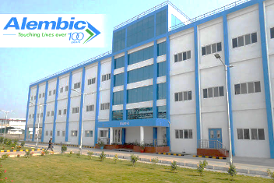

Financial statement analysis
School of Management Studies
Accounting for Managers
Submitted to: Dr. Siva Krishna Golla

Slide 2

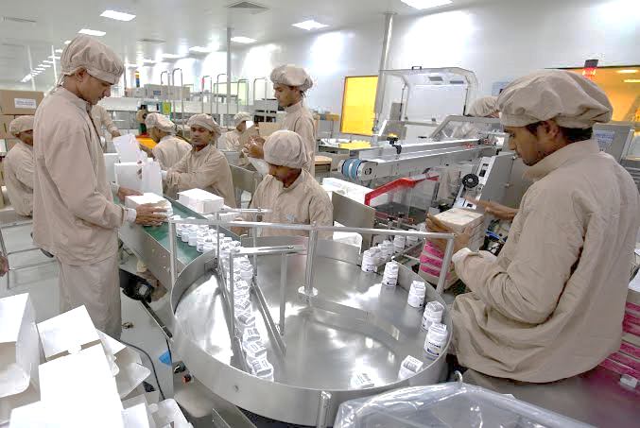
Introduction
Alembic is a multiproduct, multi-platform, multi-location enterprise working with some of the biggest pharmaceutical companies in the world to deliver a variety of complex chemistries.
The major products include Pharmaceuticals, Branded and Generic drugs. It is involved in manufacturing and marketing India Formulations, International Generics, and Active Pharmaceutical Ingredients with vertical integration capabilities.
The Company specializes in manufacturing and marketing generics and active pharmaceutical ingredients at its 9 state-of-the art manufacturing facilities in Gujarat and Sikkim.
The product development is pivoted at R&D centers in Vadodara and Hyderabad. Alembic ranks 20th in the Indian formulations market.
In the US market, the Company has established its presence with a healthy product basket and a reputation as a reliable partner.
The company’s equity is listed on the BSE Limited and the National Stock Exchange of India Limited. Also serves the employment to 9000+ employees

Slide 3









Board of directors
Mr charyu amin
Mr. pranav amin
Mr shaunak amin
Mr. paresh saraiya
Mr . Raj kumar baheti
Mr .k.g Ramanathan
Mr. paravan parikh
Dr. Archana hingorani

Slide 4
COMPARATIVE STATEMENT

Slide 5
Common size statement analysis
Balance sheet
Income statement

Slide 6
Trend analysis

Slide 7
RATIOS
FINACIAL RATIOS FOR YEAR 2019-2023
 | FINANCIAL RATIOS | FORMULA | 2018-19 | 2019-20 | 2020-21 | 2021-22 | 2022-23
 | CURRENT RATIOS | CURRENT ASSETS/CURRENT LIABLITIES | 1.48 | 1.48 | 1.8 | 1.74 | 1.78
 | DEBT-EQUITY RATIO | TOTAL DEBT / SHAREHOLDER'S EQUITY | 0.68 | 0.76 | 0.33 | 0.34 | 0.41
 | RETURN ON INVESTMENT | PROFIT BEFORE TAX/TOTAL ASSET | 16.81% | 20.02% | 20.91% | 9.30% | 0.06
 | CAPITAL TURNOVER RATIO | SALES / CAPITAL EMPLOYED | 1.11 | 0.93 | 0.93 | 0.92 | 1.24
 | NET-PROFIT RATIO | NET PROFIT / SALES * 100(%) | 16.7 | 23.46 | 23.27 | 10.79 | 6.05
 | RETURN ON CAPITALEMPLOYED | EBIT / CAPITAL EMPLOYED*100 | 23.11% | 26.59% | 25.97% | 11.98% | 8.48%
 | RETURN ON EQUITY | EAT - PREFERENCE SHARE DIVIDEND / SHAREHOLDER'S EQUITY*100 | 22.53% | 28.97% | 22.37% | 10.27% | 7.83%

Slide 8
INTERPRETATION
Current Ratio:
The current ratio indicates the company's ability to cover short-term liabilities with short-term assets. An upward trend from 2018-19 to 2022-23 suggests an improvement in short-term liquidity. However, the ratio fluctuates slightly, indicating possible variations in managing current assets and liabilities over the years
Debt-Equity Ratio :
A decreasing trend from 2018-19 to 2022-23 suggests a reduction in financial leverage. Lower debt in relation to shareholder equity can be favorable as it signifies lesser dependency on debt financing. The company seems to be gradually relying more on equity financing.
Return on Investment (ROI):
There's a decline in ROI from 2020-21 to 2022-23, indicating a decrease in profitability in relation to total assets. The sharp drop in 2022-23 might indicate a significant change in the company's operations or financial structure that affected its profitability adversely.

Slide 9
INTERPRETATION
Capital Turnover Ratio:
A fluctuating but overall slightly declining trend in the capital turnover ratio indicates that the company might not be using its capital as efficiently to generate sales. However, the increase in 2022-23 could signify a recent improvement in this area.
Net Profit Ratio:
The trend here shows a decrease in net profit in relation to sales, indicating a reduction in profitability. The decreasing trend might suggest increased costs or decreased revenues affecting overall profitability.
Return on Capital Employed (ROCE):
There's a consistent decline in ROCE from 2019-20 to 2022-23, suggesting a reduced ability to generate profits from the capital employed in the business. This might indicate operational inefficiencies or less effective utilization of capital.
Return on Equity (ROE):
The decreasing trend in ROE indicates a decline in profitability concerning shareholder equity. This could imply lower returns for shareholders over the years, possibly due to lower profits or increased equity.

Slide 10

012300400013002003 Anushka Shanker
Comparative Analysis, Common Size and Trend Analysis and interpretation , presentation preparation
012300400013002007 Dhruvi Y. Vyas
Balance Sheet and Profit & Loss Account, Comparative Analysis, Merging the data
012300400013002012 Jayatikumari Zala
Ratio Analysis & Interpretation
Thank you

